Slide 1
Data-Driven Marketing
Intelligence Platform
Software Engineering
Faculty of Engineering
Ben Gurion University of the Negev

Slide 2
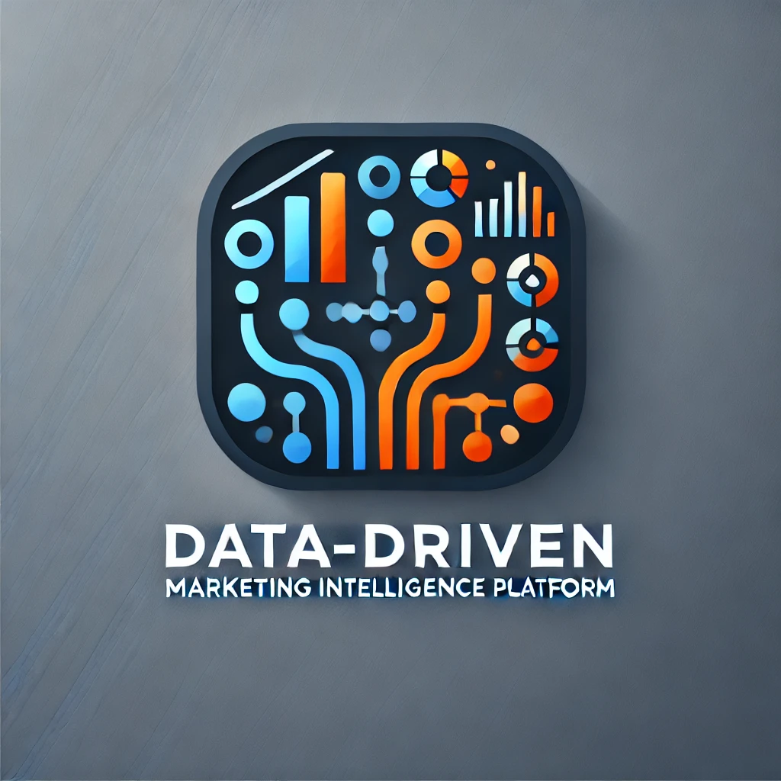
Team Details
Student Name | ID | Email | Phone | Signature
Evyatar Kopans | 209130335 | kopansev@post.bgu.ac.il‏ | 052-790-3414
Yuval Goldstein | 208668442 | golyuval@post.bgu.ac.il | 052-725-2886
Ron Franco | 206556045 | ronfr@post.bgu.ac.il | 055-954-2077
Peleg Ben Barak | 207233560 | benbapel@post.bgu.ac.il | 050-679-2401

Slide 3
Customer:
User1st
User1st’s Representative: Ariel Orbach
Role: Co-Founder CTO
Email: ariel.orbach@user1st.com
Phone: Number +972-(0)5203000970
Address: Azrieli Sarona Tower - Derech Menachem Begin 121, Tel Aviv-Yafo
Other advisors will also be appointed for specific purposes such as: CMO, Product Department, Compliance, Backend & Frontend architects, infrastructure / DevOps / SRE / Data / Sales)

Slide 4
Introduction
In today's competitive digital landscape, data-driven strategies are essential for optimizing marketing efforts.
Traditional methods lack the agility to adapt to changing markets and customer behaviors.
This project aims to build a data-centric platform offering real-time marketing insights, leveraging analytics and machine learning to improve performance, eliminate inefficiencies, and reduce costs.

Slide 5

Problem Description and motivation
The marketing domain has shifted from intuition-based decision-making to data-driven approaches.
Marketing departments are constantly challenged to measure the effectiveness of their campaigns, allocate resources wisely, and refine their strategies to achieve maximum impact with minimal expenditure.

Slide 6
Our solution
Data-Driven Marketing Intelligence Platform.
Our system aims to solve the problems of intuition-based approaches by gathering and analyzing important user data (Lead Analysis), while also setting up crawlers to scan important areas in the web and gather new leads (Lead Generation).

Slide 7
Our solution’s functionalities
what data we want to collect?
Canceling actions performed by the User in our site (from google analytics)
Gathering frequently searched keywords to improve SEO (from google analytics, LinkedIn premium, Meta developers).
ROI per campaign (=ads in social networks/ search results).
Geographic users’ location distribution (google analytics)
Demographic users’ data (google analytics: gender, age, education, profession, mobile/web user ..)
Manually filled forms by potential clients/buyers to detect our ICP (a form filled by an interested user fits out ICP better than an intrigued user browsing LinkedIn).
* Some data already exists in raw-data form only, and needs to be displayed

Slide 8
Our solution’s functionalities
Additional functionalities
Simultaneously publishing posts at multiple social and business networks.
ROI stopping point calc per campaign (online algorithms – check).
Easy interfacing with social network campaigns analysis/ pulling all relevant data into our system.
Lead score for each user (0 – will not buy/ 100 - will probably buy)
The system will handle a stateful key-value storage (key – userIP, value – user Cookies)
Nice to have!
Automated crawlers searching for tech-influencers and client companies' representatives. (for example – zoom info’s marketplace contains a lot of commercial companies' websites – and we can use tools like “wave” to scan the site for accessibility flaws).
Use an AI model with all our collected data to grant the lead Score for each user.

Slide 9
Project goals
Project goals
Develop a comprehensive and accurate ICP monitoring system – because we still don’t have refined ICP and our customer profile might shift overtime.
Deep dive into the intersection of technology, data analytics, and marketing strategy, while also understanding how businesses operate and make strategic decisions.
Performance Benchmarking: Compare marketing activities to industry standards and competitors, identifying improvement opportunities.
Real-Time Analytics & Visualization: Provide real-time insights through advanced analytics and intuitive dashboards for campaign effectiveness, engagement, and ROI

Slide 10
Current Students Resources
Educated Staff: User1st's team is highly skilled and knowledgeable, bringing expertise across various domains of marketing, data analysis, and technology. Their solid professional expertise background ensures a deep understanding of both the industry and technical aspects of the project.
Agility in Learning: Our team has a proven ability to quickly absorb new information and adapt to emerging systems and coding languages. This flexibility enables us to integrate the latest tools and technologies, ensuring that our platform remains cutting-edge and effective.
Support from Academia: We can leverage partnerships with BGU to gain insights into the best practices in data analytics, machine learning, marketing strategies and other useful information.
Access to User1st’s google analytics, LinkedIn profile, meta-accounts, cloud account.

Slide 11
Project’s Risk Assesment (and how we’ll overcome)
Challenge | How to overcome?
New Programming Languages & Technologies | Provide hands-on training sessions, pair programming, and access to online tutorials and resources to accelerate the learning curve.
UTM Analysis Complexity | Use automated tools for UTM tracking and regularly validate the accuracy of UTM data to ensure precise attribution.
Integration with Multiple Data Sources | Develop standardized data formats and use ETL (Extract, Transform, Load) tools to streamline data integration. Ensure API compatibility and run integration tests regularly
Adopting Machine Learning Models | Continuously refine models with diverse datasets and validate their accuracy against real-world outcomes.

Slide 12











Project’s Environments and Language
Backend
Frontend
Our learning platforms:

Slide 13
Evaluation and Testing Plan
Unit Testing on individual classes and components and individual modules
QA testing
Acceptance Testing for system requirements
Manual UI/UX Testing with users
Test for security vulnerabilities
Test performance under high user load
Notes:
גל

Slide 14
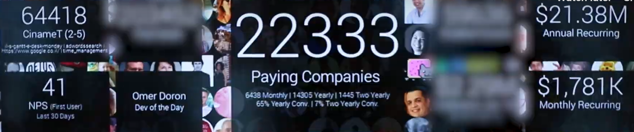
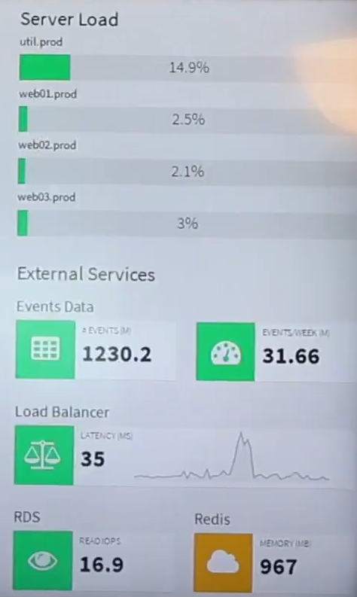
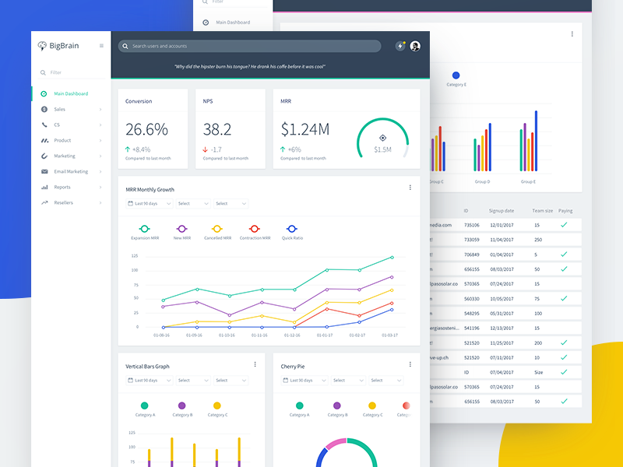
UI Example Of a Marketing Intelligence System

Slide 15
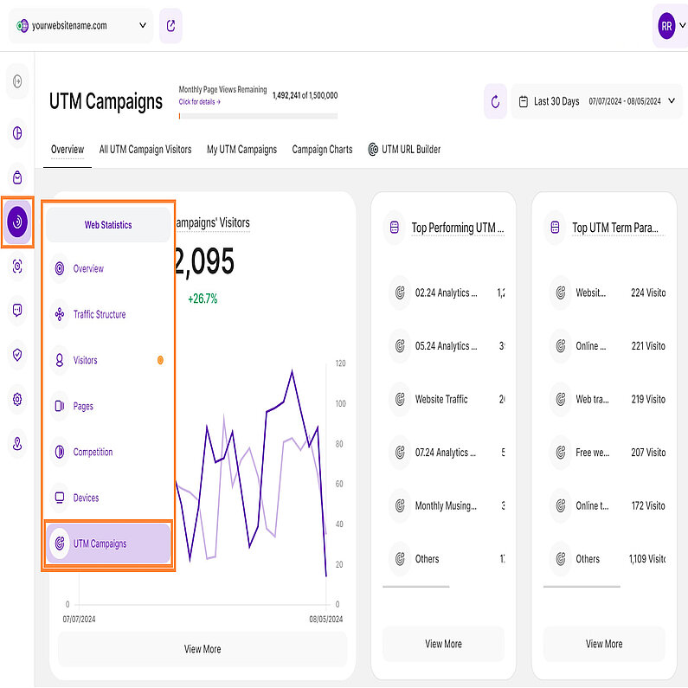
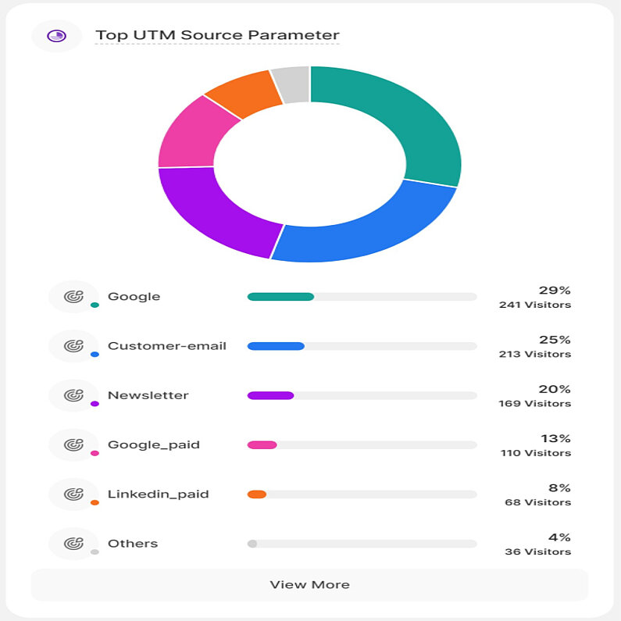
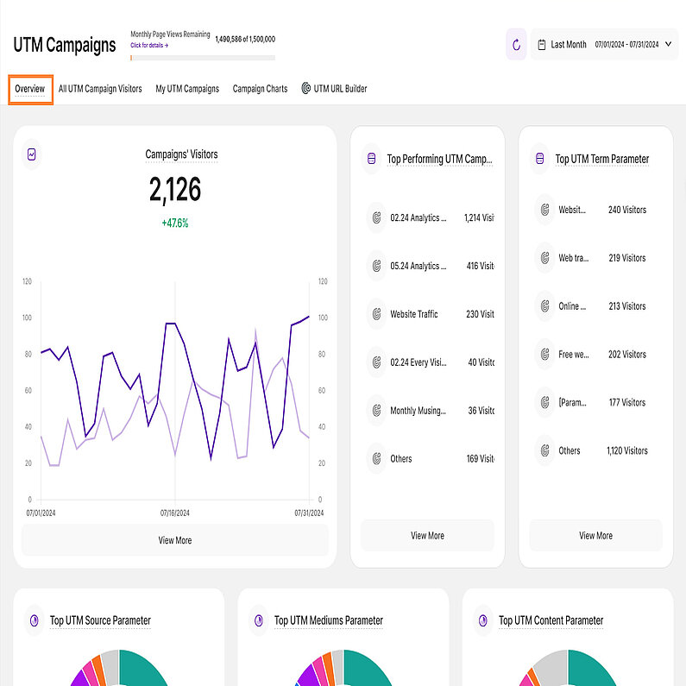
UI Example (UTM parameters handing)
* More advanced and thorough design will be published after the PRD review and requirements gathering.

Slide 16
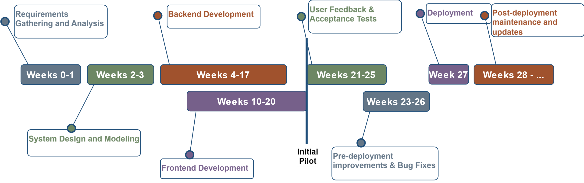
Project Timeline

